Slide 1
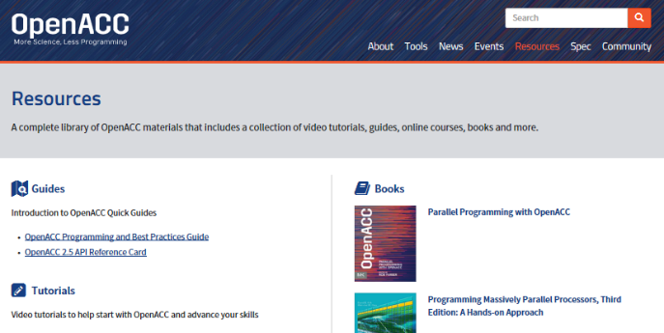
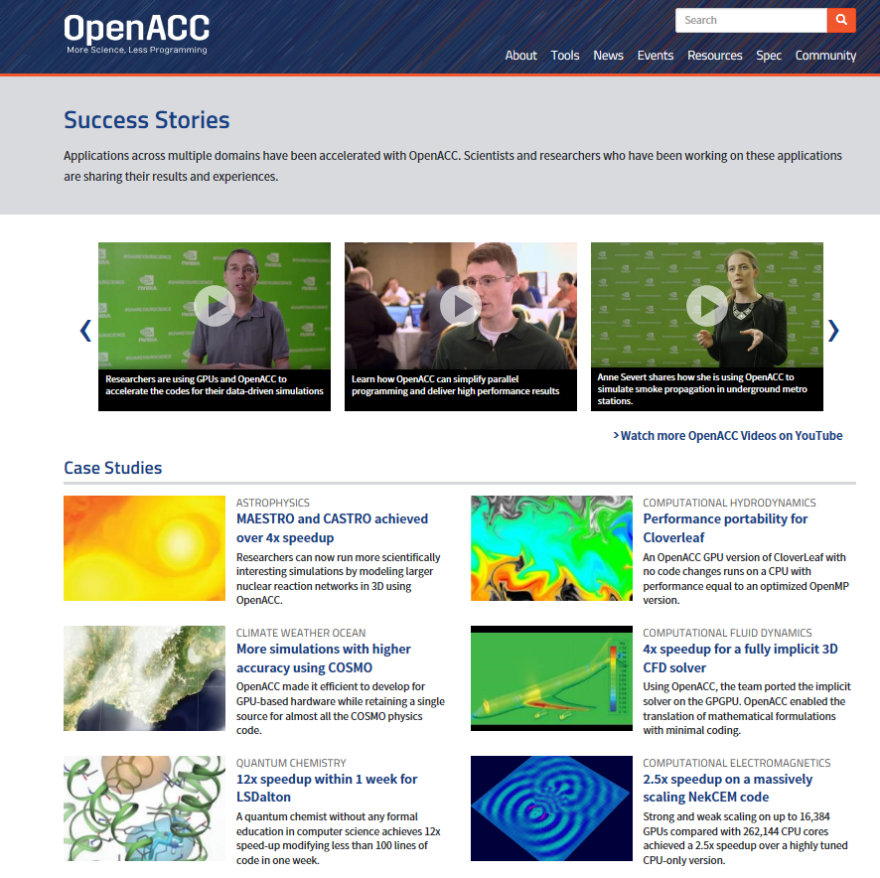


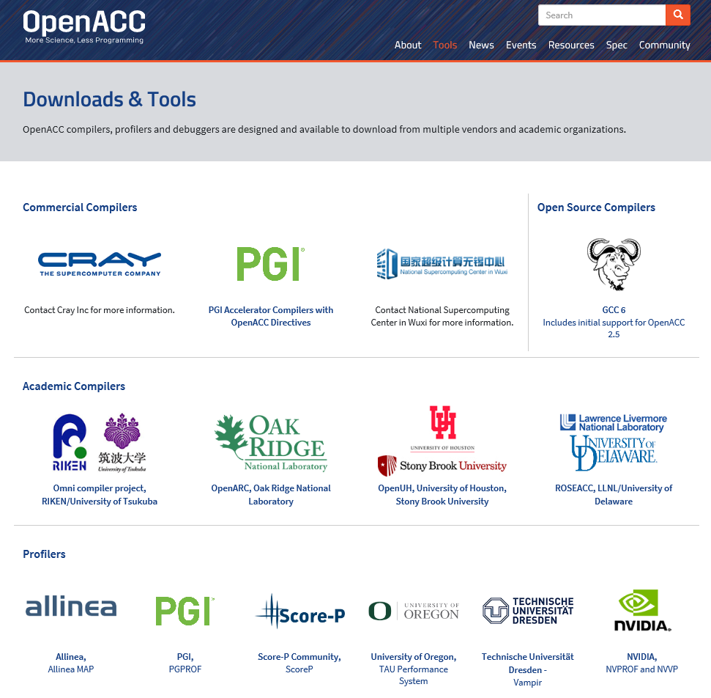
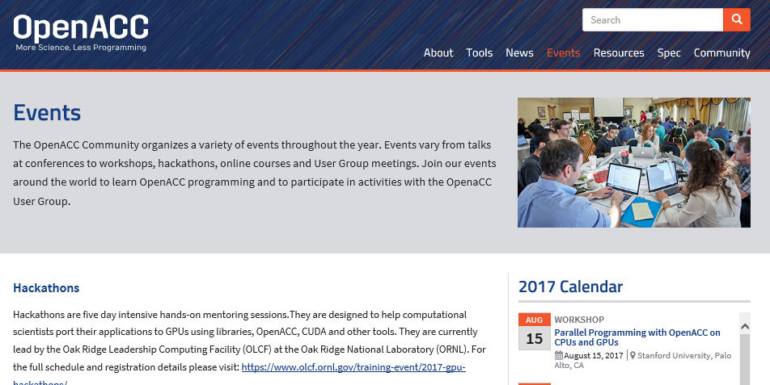
OPENACC Resources
Guides ● Talks ● Tutorials ● Videos ● Books ● Spec ● Code Samples ● Teaching Materials ● Events ● Success Stories ● Courses ● Slack ● Stack Overflow
Resources
https://www.openacc.org/resources
Success Stories https://www.openacc.org/success-stories
FREE
Compilers
Compilers and Tools https://www.openacc.org/tools
Events
https://www.openacc.org/events

